Slide 1
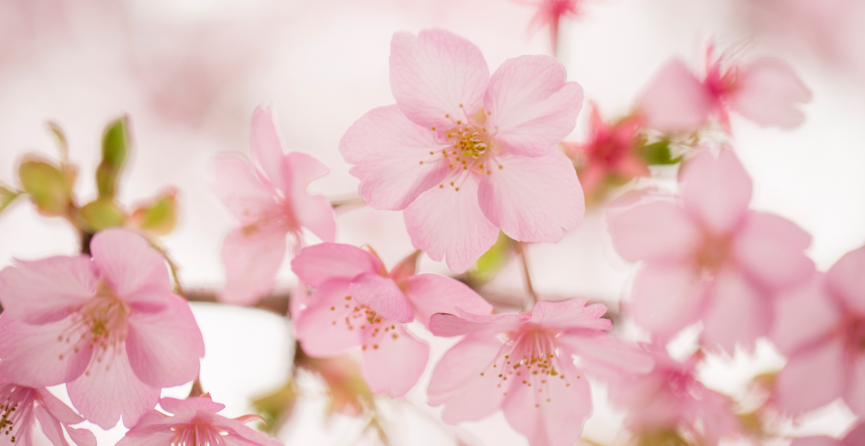
About me by Leo Chau (4B)
My name is Leo Chau. I am nine years old. I am 1.16 metres tall. I am 46 kg. I have a younger brother. My favourite colour is cyan.
I like playing computer games. I always play computer games at home. I like reading books too. Sometimes I read books at home. I like watching TV a lot and I like drawing too.

